Slide 1
Phong Shader
Dr. Hamish Carr Dr. Rafael Kuffner dos Anjos

Slide 2
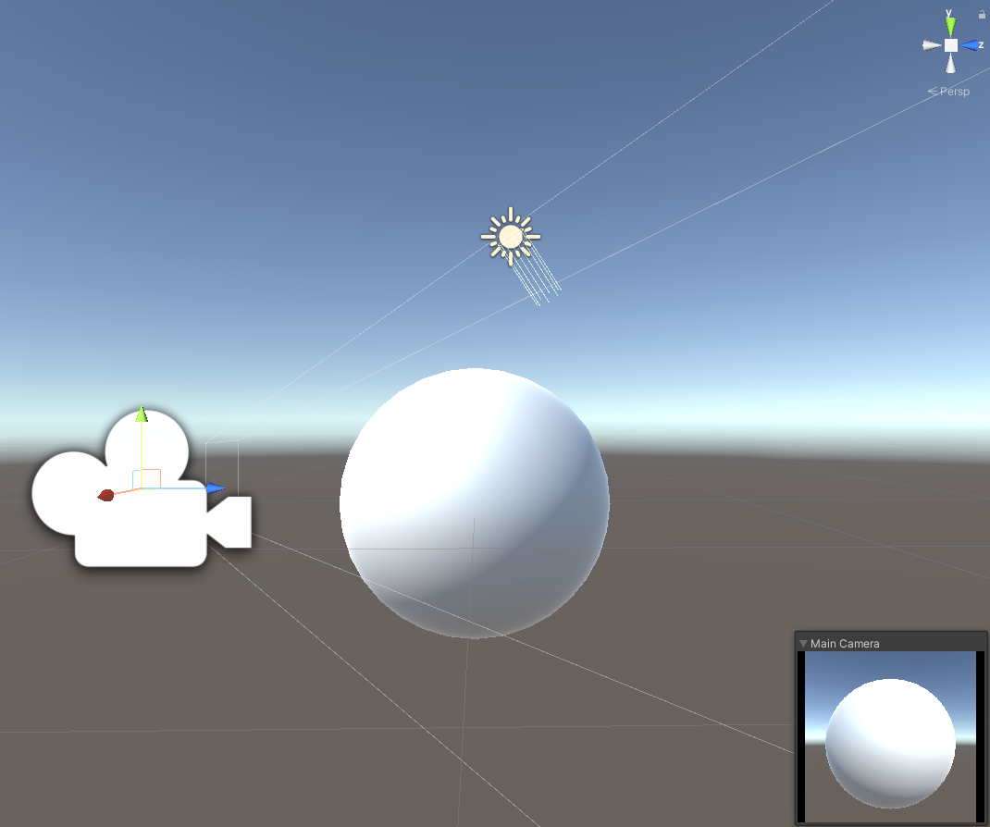
Phong Shading
The first real shader people write
Per-pixel Blinn-Phong illumination
Just “Phong” is rarely used anymore. So when we say Phong we normally mean Blinn-Phong
Pass all material properties as vertex attributes
Interpolate the normal vector
In view/world coordinates
Properties of the light are uniform
Since they're the same everywhere

Slide 3
Fixed Function Pipeline
Vertex stage transforms vertices
Performs lighting calculations
Passes colour to rasteriser
Rasteriser interpolates colour
This is called Gouraud shading
Fragment stage combines with texture
And stores in frame buffer

Slide 4
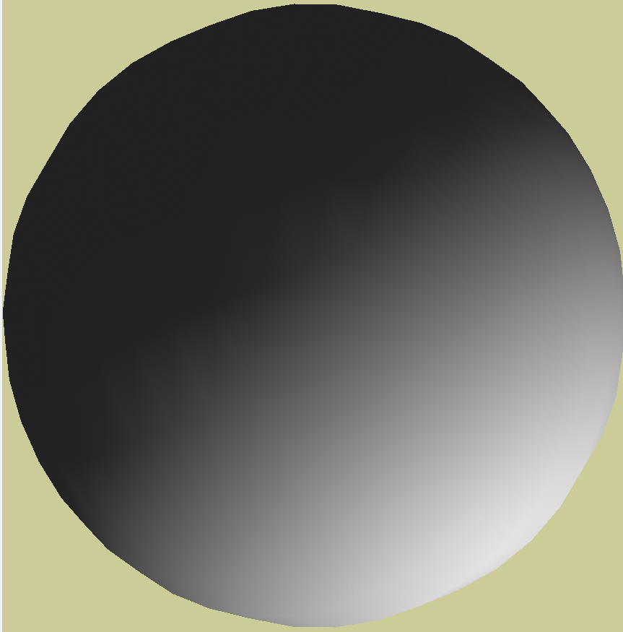
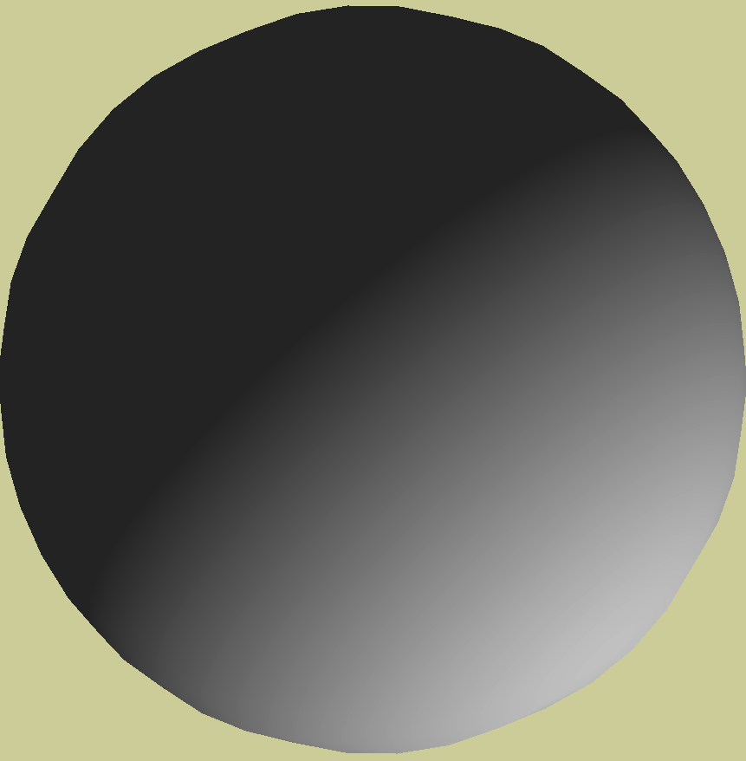

Gouraud vs. Phong Shading
Phong shading is the ideal
Every pixel computes its own lighting
But this is (was) expensive
Gouraud shading is a hack
Interpolate colour over each triangle
Much cheaper
But many fragments => many computations
COMP 5812M: Foundations of Modelling & Rendering

Slide 5
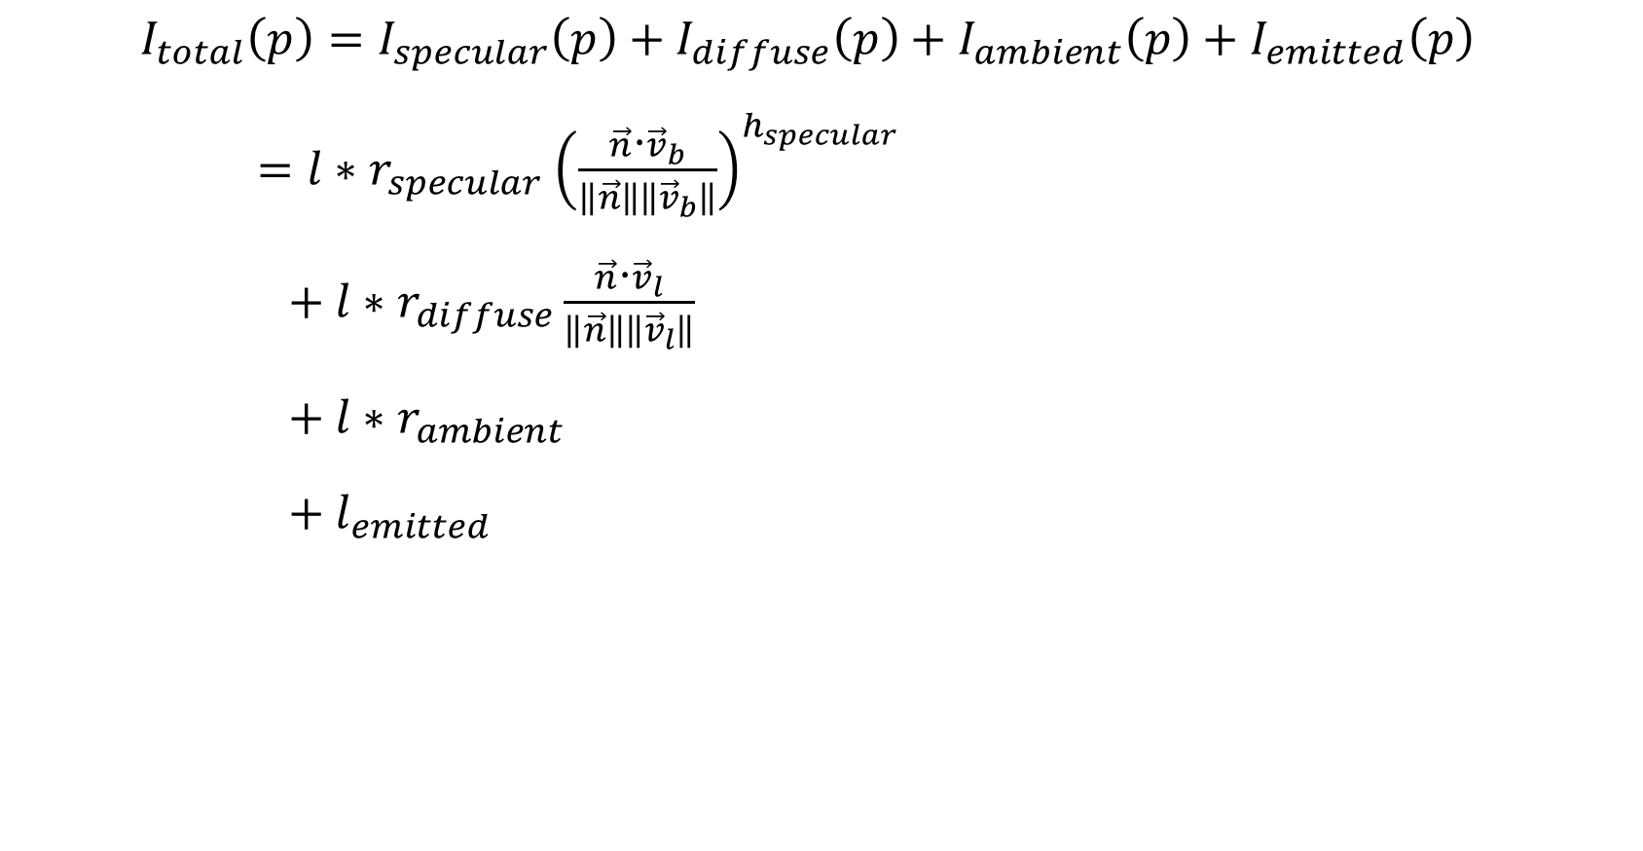
Recap: Blinn-Phong model
$$I_{total}\left(p\right)=I_{specular}\left(p\right)+I_{diffuse}\left(p\right)+I_{ambient}\left(p\right)+I_{emitted}\left(p\right)$$
$=l{∗r}_{specular}{\left(\frac{\vec{n}\text{⋅}{\vec{v}}_{b}}{\left\|\vec{n}\right\|\left\|{\vec{v}}_{b}\right\|}\right)}^{h_{specular}}$
$+ l∗r_{diffuse}\frac{\vec{n}\text{⋅}{\vec{v}}_{l}}{\left\|\vec{n}\right\|\left\|{\vec{v}}_{l}\right\|}$
$+ l∗r_{ambient}$
$+ l_{emitted}$

Slide 6
Goal
Blinn-Phong shading in fragment shader
Needs as input:
Fragment (position implicit)
Normal (in WCS or VCS)
Light vector (ditto)
Material properties
So vertex shader has to pass them through
COMP 5812M: Foundations of Modelling & Rendering

Slide 7
Vertex Shader Inputs
Vertex Buffer:
Vertex position, normal
Vertex Color
Uniform Buffer:
Light position & properties
Transformation Matrices
Vertex texture coordinates
COMP 5812M: Foundations of Modelling & Rendering

Slide 8
Vertex Shader Outputs
Vertex positions in NDCS
Normals in VCS
Light vectors in VCS
Vertex colors
Texture coordinates
COMP 5812M: Foundations of Modelling & Rendering

Slide 9
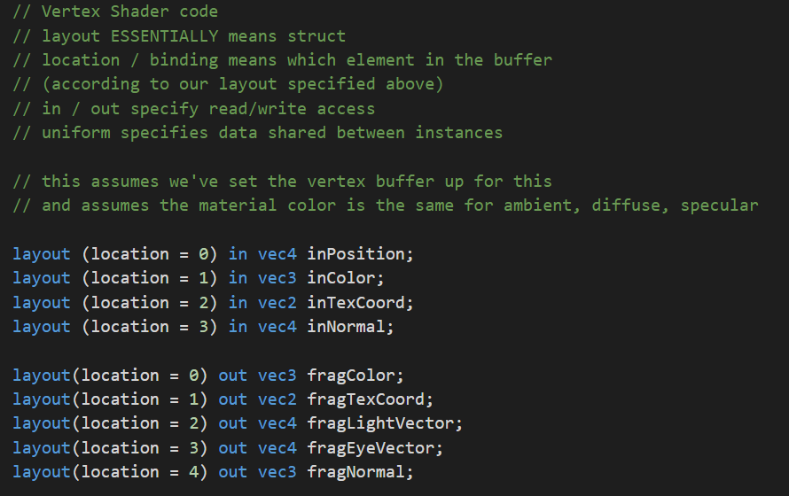
Vertex Shader I/O

Slide 10
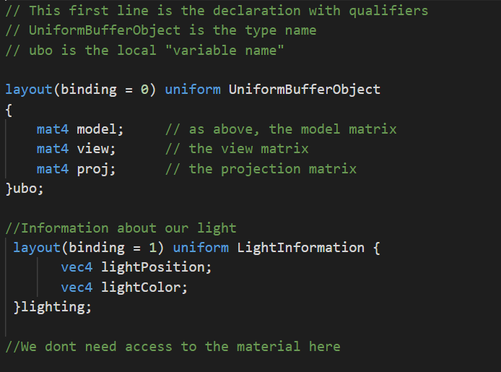
Vertex Shader Uniforms

Slide 11
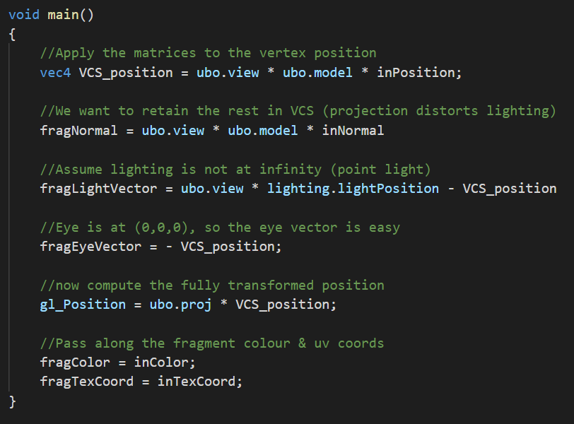
Vertex Shader Main()

Slide 12
Raster Stage
Rasterises from vertex positions (NDCS)
Interpolates
Normals (VCS)
Light vectors (VCS)
Lighting colour (RGB)
Material properties (if desired)
Texture coordinates (UV)
COMP 5812M: Foundations of Modelling & Rendering

Slide 13
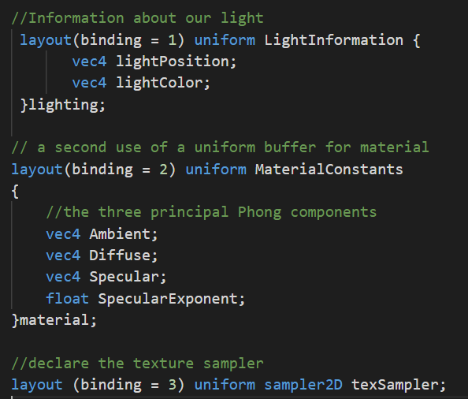
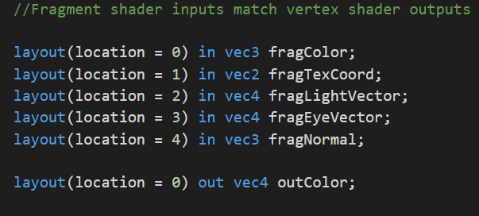
Fragment Shader I/O and Uniforms

Slide 14
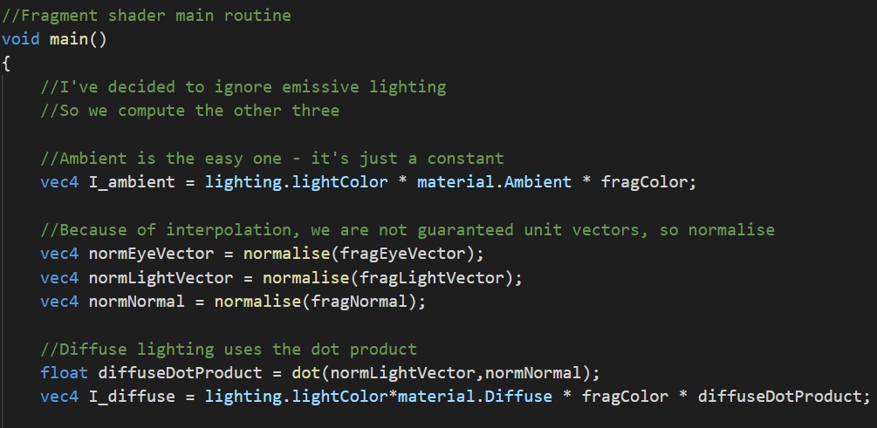
Fragment Shader Main(), I

Slide 15
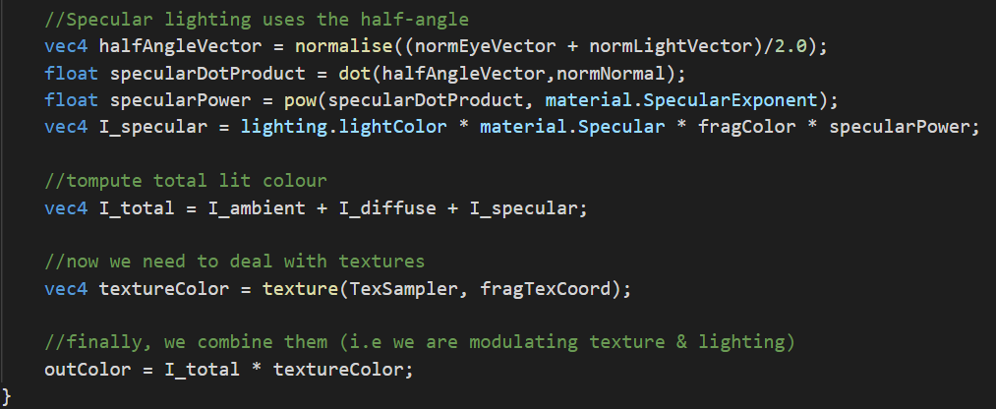
Fragment Shader Main(), II

Slide 16
Blinn-Phong shader
There are variants of this that are equally OK.
Per-vertex material.
Lighting with colour per each component
Non modulating with texture
Texture mapping material properties
Etc.

Slide 17
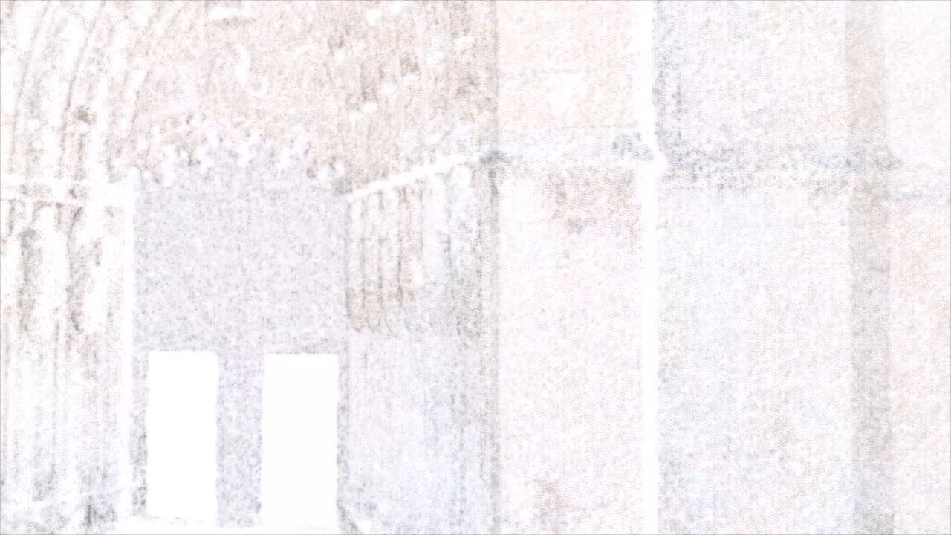
Extra exemple: Geometry Shader
As this lecture was quick, lets look at a different example:
Geometry shader for point-cloud rendering
Input: Points and normals.
Normals calculated offline by PCA of a neighborhood of points
Output: quads oriented towards normals.
Simple version just has normals pointing at the camera: Billboards!

Slide 18
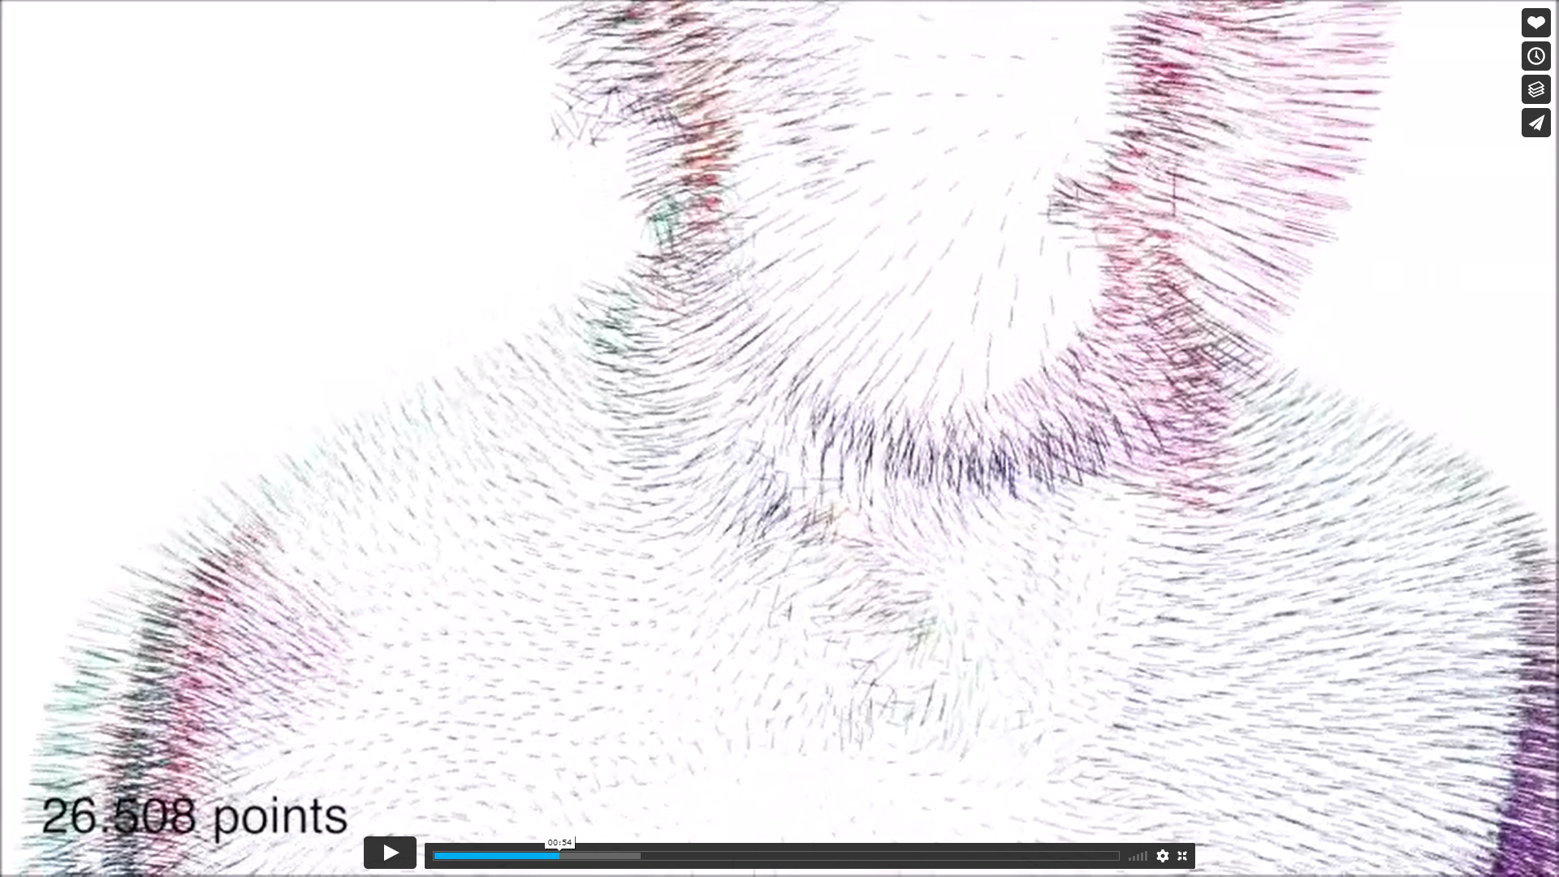
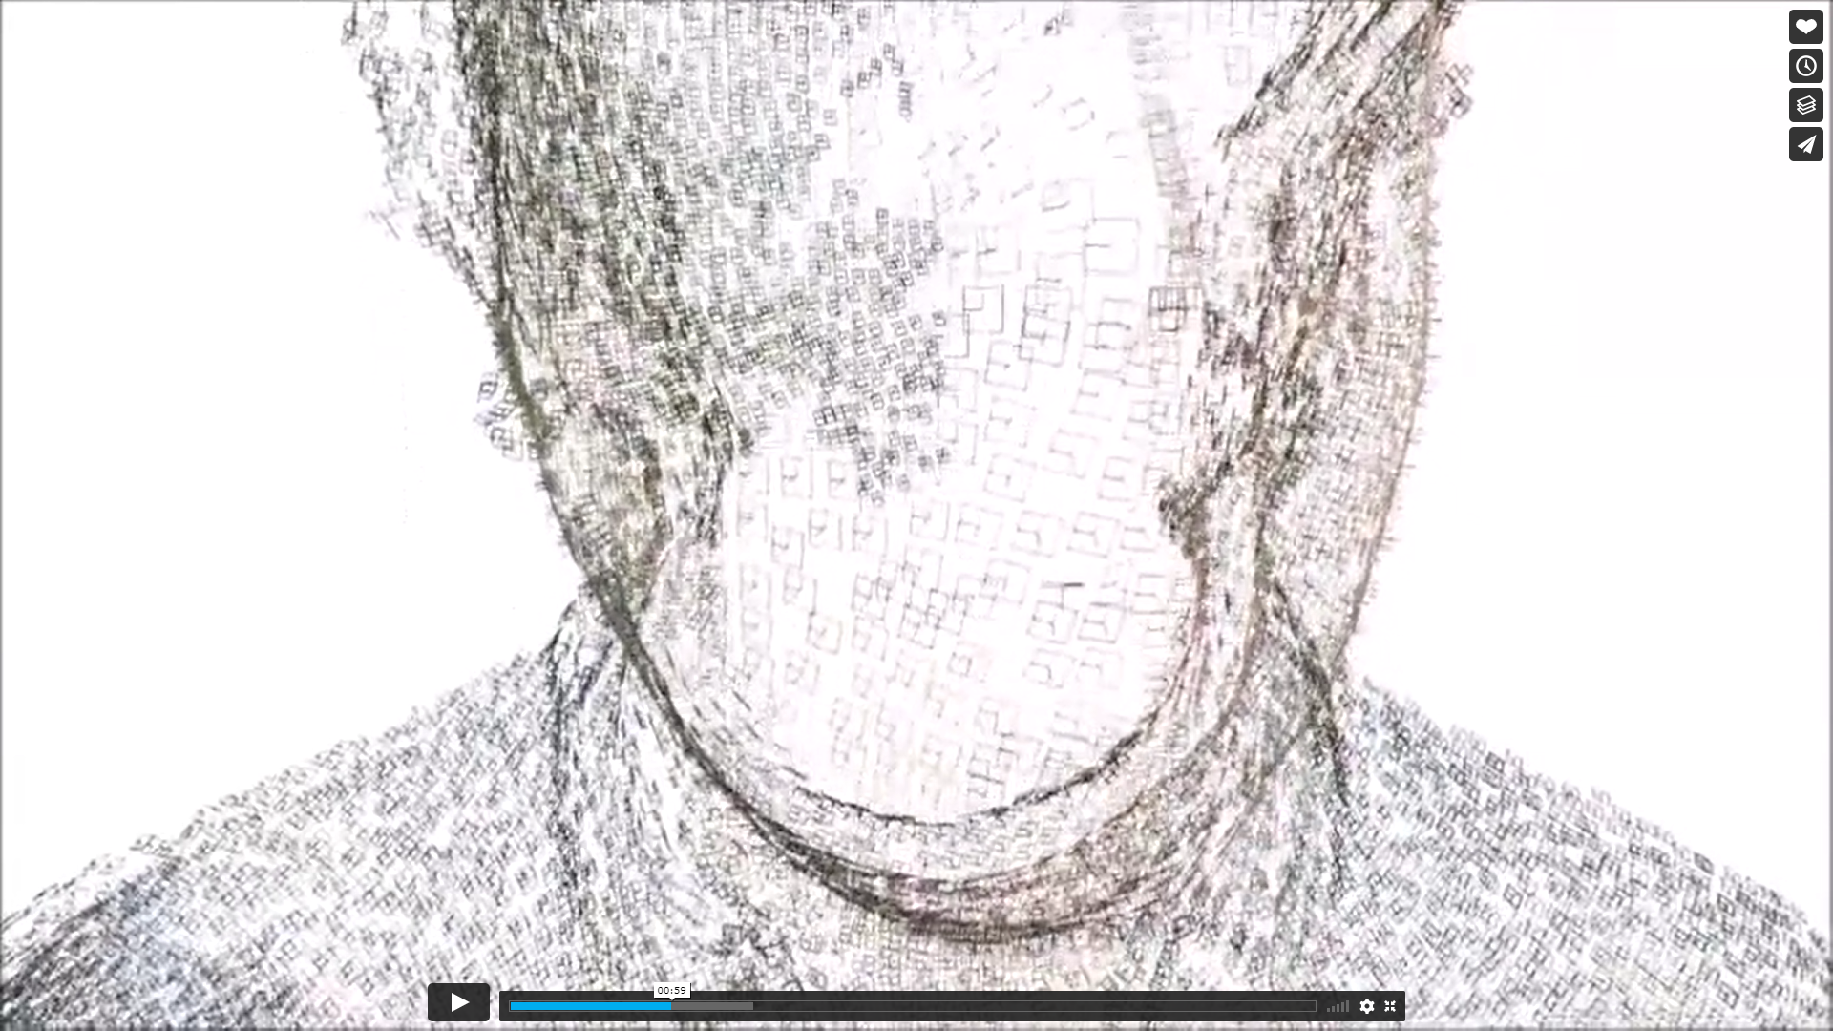
Surface-aligned splats
Given the normal and point
Find 2 orthogonal vectors in that plane (several possible methods)
Generate a quad of size s
Filter it in fragment shader

Slide 19
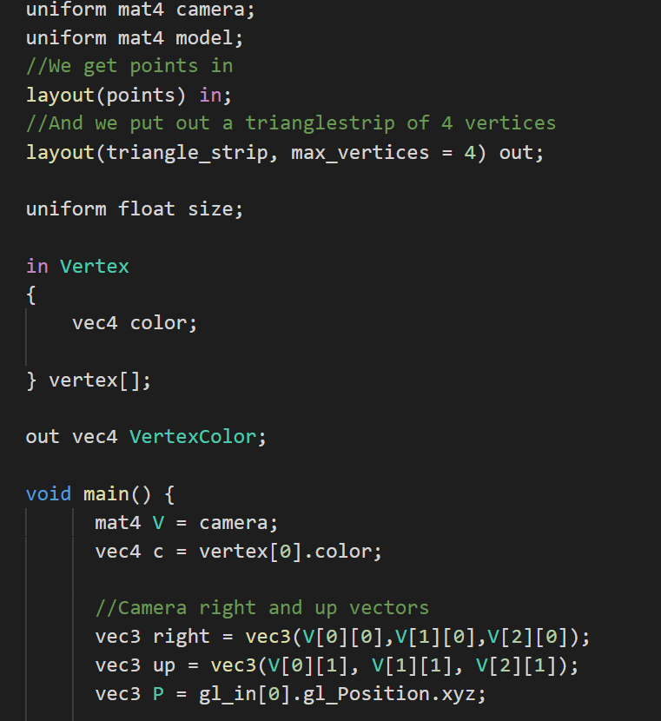
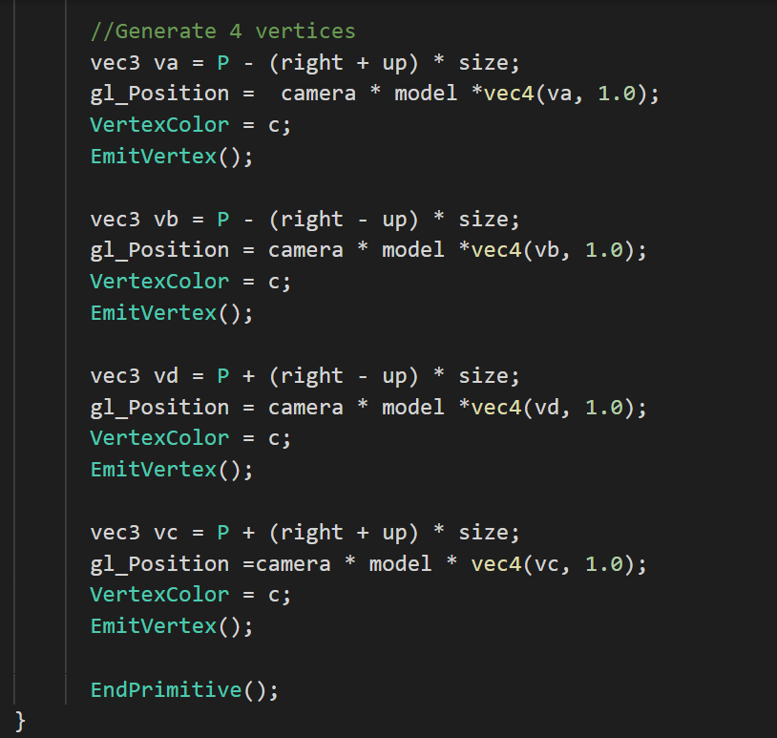
Simple version: Camera aligned

Slide 20
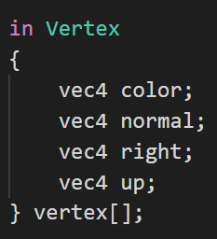
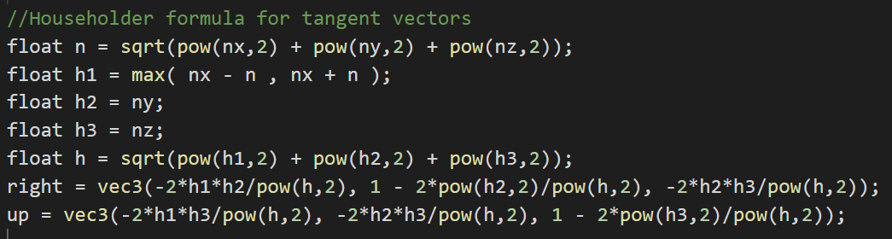
Surface-aligned
Small changes:
Add tangents as parameters
2 float3 per point: more bandwidth
Calculate in real-time

Slide 21
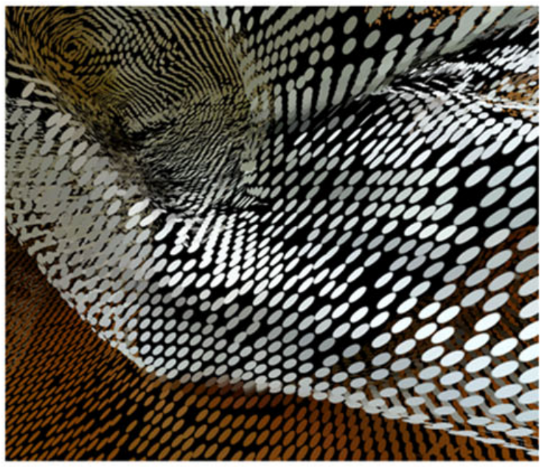
Fragment shader
If you add UV to each emitted vertex, it gets interpolated over quad.
Useful to render circles instead of squares.
Or any other shape you like.

Slide 22
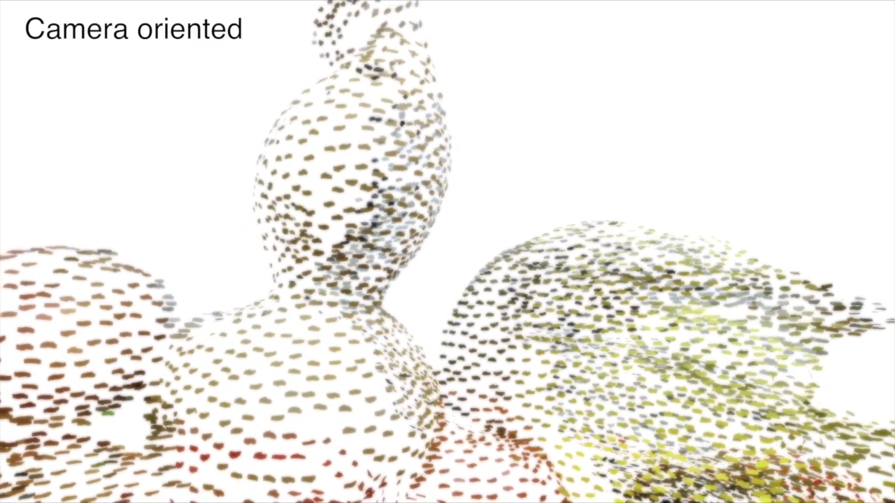
Example of different tangent vectors

